Slide 1
Lecture 25
Multiple Linear Regression

Slide 2
Example: Where to locate a new motor inn?
  La Quinta Motor Inns is planning an expansion.
  Management wishes to predict which sites are likely to be profitable.
  Several areas where predictors of profitability can be identified are:
    Competition
    Market awareness
    Customers
    Community
    Physical quality

Slide 3
Margin
Profitability
(%)
Market
awareness
Competition
Customers
Community
Physical
Rooms
Nearest
Office
space
College
enrollment
Income
Disttwn
Number of
hotels/motels
rooms within
3 miles from
the site
(rooms)
Distance to
the nearest
competitor
(miles)
Median
household
Income
($1000)
Distance to
downtown
(miles)
(1000
sq-ft)
Number of
college students
around the site
(1000)

Slide 4

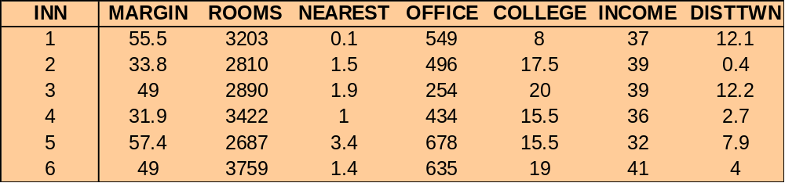
  Data was collected from randomly selected 100 inns that belong to La Quinta, and ran for the following suggested model:
Margin =β₀ + β₁Rooms + β₂Nearest + β₃Office + β₄College
+ β₅Income + β₆Disttwn +

Slide 5
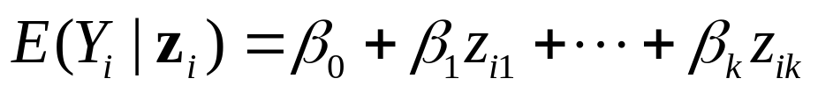
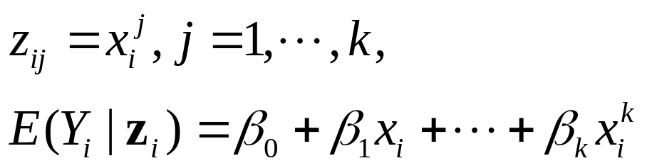
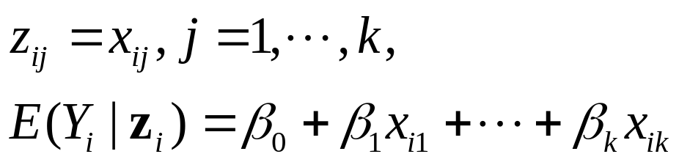
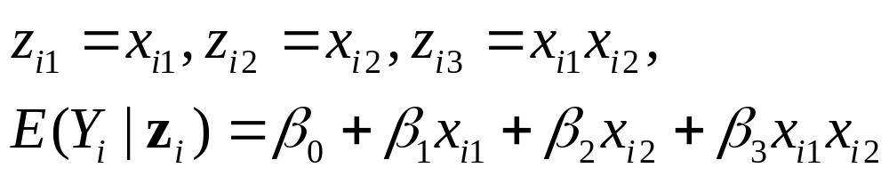

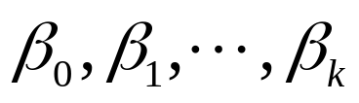
Multiple Linear Regression
E.g.
E.g.
E.g.
The term linear refers to the fact that the expectation of is a linear function of the unknown parameters

Slide 6

Classical Assumptions
Linearity:
Normality: each variable Yi has a normal distribution.
Independence: the variables Y1,…,Yn are independent.
Homoscedasticity: the variables Y1,…,Yn have the same variance .

Slide 7
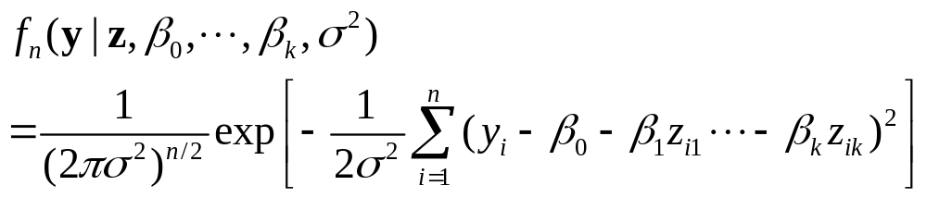
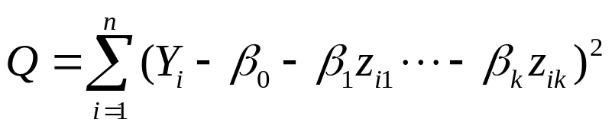
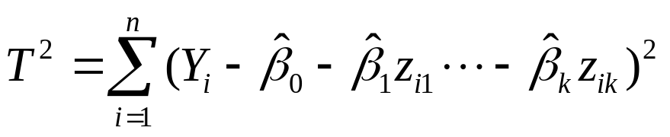

Maximum Likelihood Estimators
The likelihood function of and :
The values of that maximize the likelihood function will be the values that minimize
So the M.L.E. of are the least square estimators.
Define
The M.L.E. for is

Slide 8
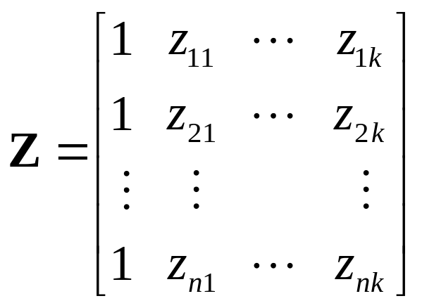
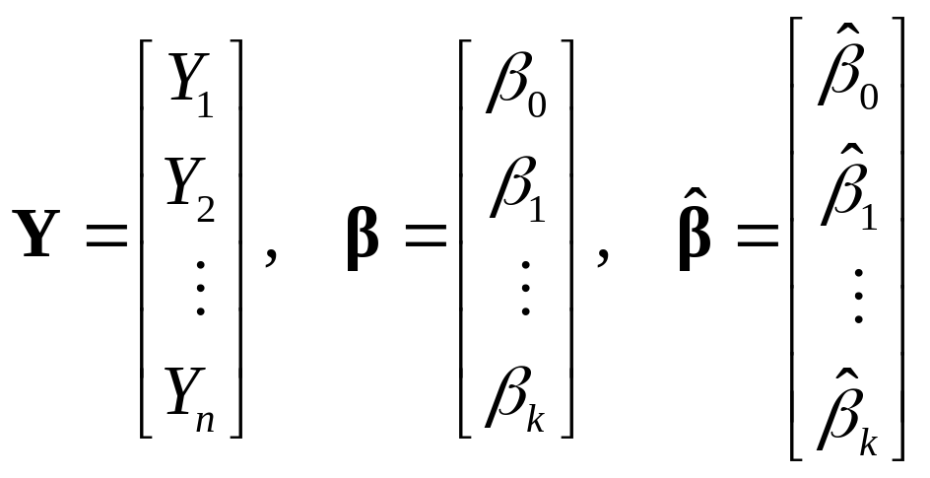
Explicit Form of the Estimators
The design matrix
Also define

Slide 9

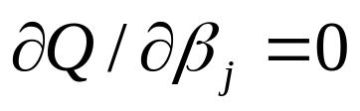

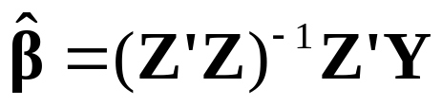
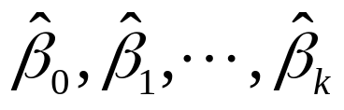
The set of k+1 normal equations (by setting j=0,…,k) can be written as:
So the least square estimators (the M.L.E.s) are:
We can see that the estimators will be linear combinations of Y1,…,Yn, so they follow multivariate normal distribution.

Slide 10
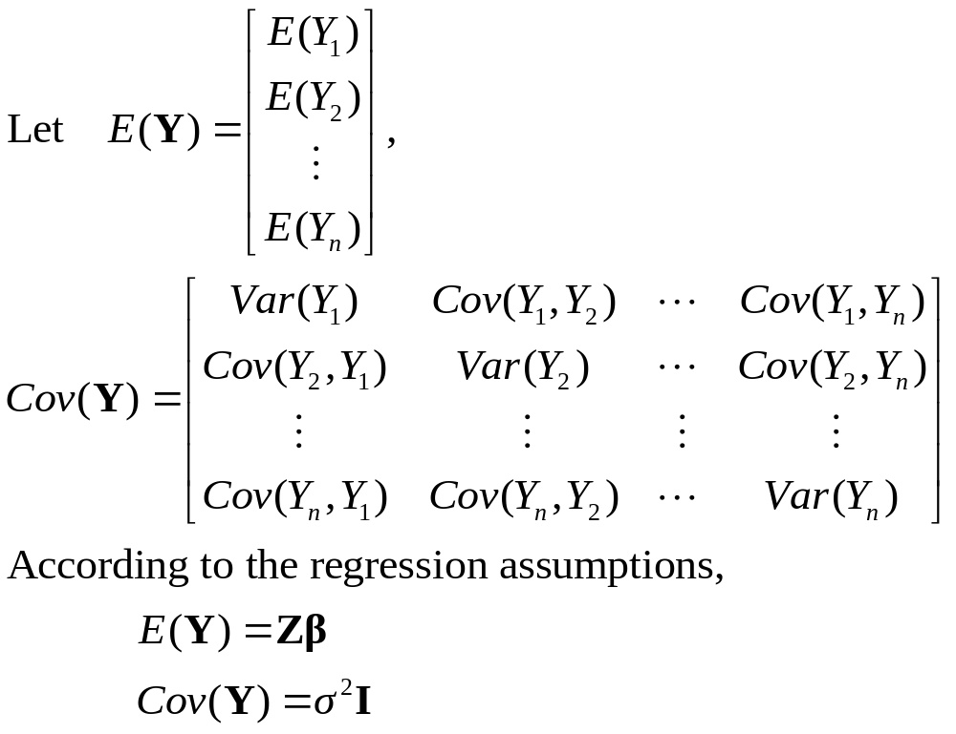
Mean Vector and Covariance Matrix

Slide 11
Theorem. Suppose that Y is an n-dimensional random vector, for which the mean vector E(Y) and the covariance matrix Cov(Y) exist. Suppose also that A is a p*n matrix whose elements are constants, and that W is a p-dimensional random vector defined by W=AY. Then E(W)=AE(Y) and Cov(W)=ACov(Y)A’.

Slide 12
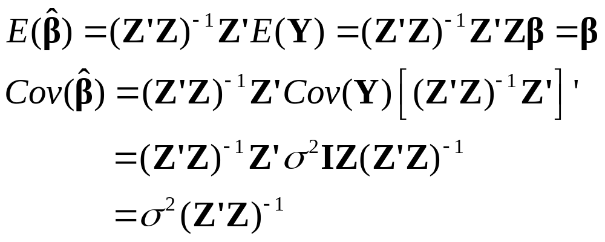
Since , we have

Slide 13


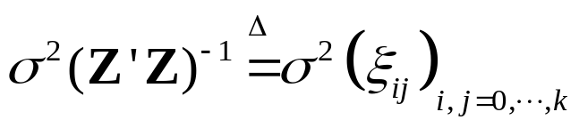





The vector has a multivariate normal distribution with mean vector and covariance matrix .
  For j=0,…,k, , marginally, has a normal distribution with mean and variance .
  For , .

Slide 14
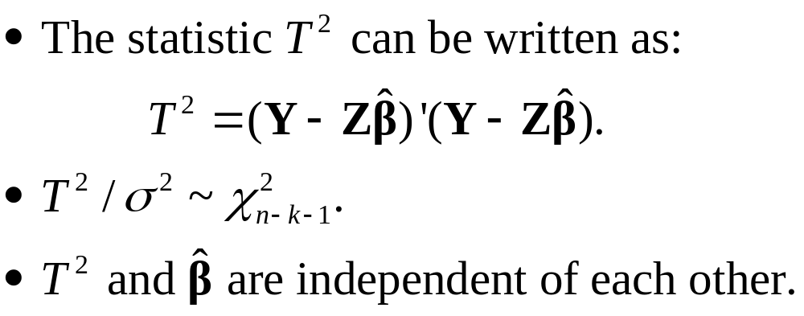
The Joint Distribution of the Estimators

Slide 15
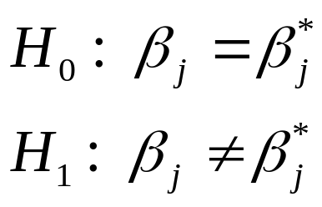
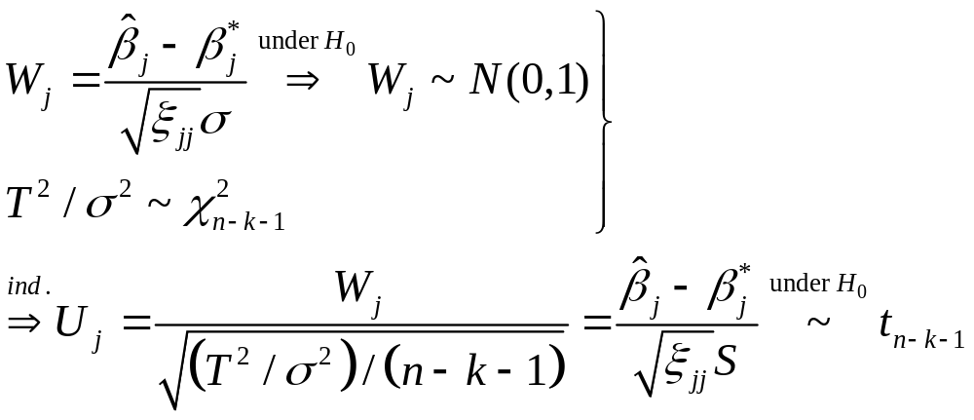
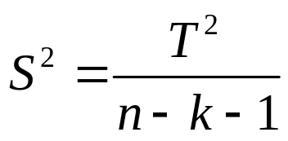

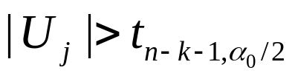
Testing Hypotheses
where is an unbiased estimator of .
The level α0 test rejects H0 if

Slide 16
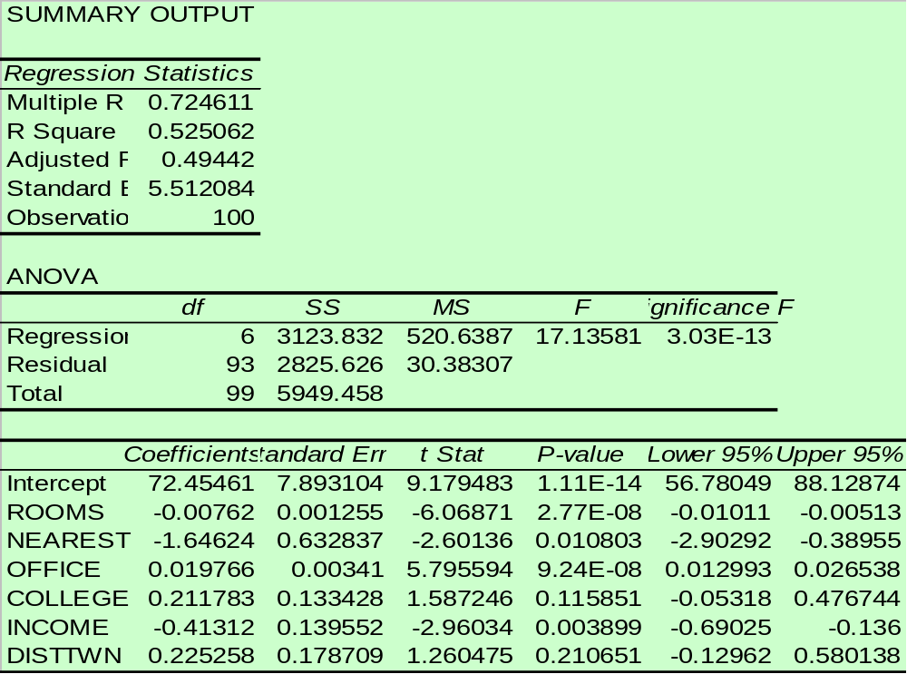
This is the estimated regression equation
Excel output
MARGIN = 72.455 - 0.008ROOMS -1.646NEAREST
+ 0.02OFFICE +0.212COLLEGE
- 0.413INCOME + 0.225DISTTWN

Slide 17
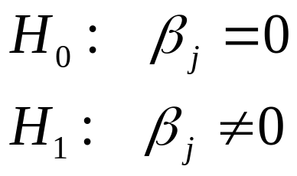
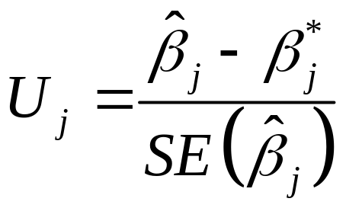
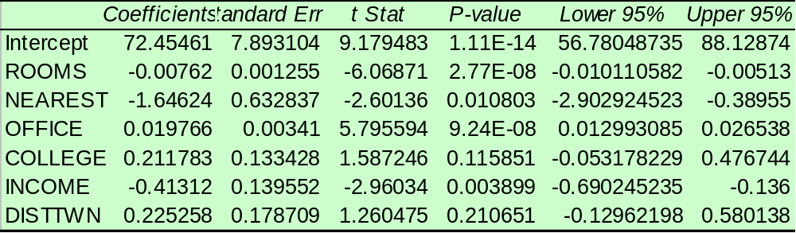
Testing the individual coefficients
  The hypothesis for each β j
  Excel printout
Test statistic
95% interval for
each β j

Slide 18



Interpretation of the Estimated Coefficients
  This is the intercept, the average value of y when all the independent variables take the value zero. Since the data range of all the independent variables do not cover the value zero, do not interpret the intercept.
  For each additional 1000 rooms within 3 mile of the La Quinta inn, the operating margin decreases on the average by 7.6% (assuming the other variables are held constant).
  For each additional mile that the nearest competitor is to La Quinta inn, the average operating margin decreases on the average by 1.65%(assuming the other variables are held constant).

Slide 19
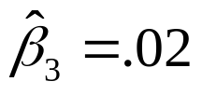

  For each additional 1000 sq-ft of office space, the average increase in operating margin will be .02% (assuming the other variables are held constant).
  For each additional $1000 increase in median household income, MARGIN decreases on the average by .41% (assuming the other variables are held constant).

Slide 20
Question
How well does the estimated regression equation fit the data?

Slide 21

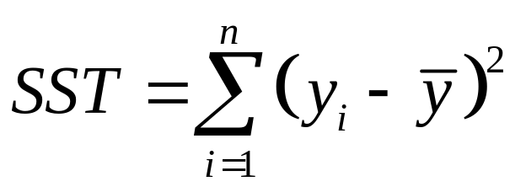
Total Sum of Squares
The sum of squared deviations obtained by using the sample mean to estimate the value of quarterly sales for each restaurant in the sample.
Total sum of squares:

Slide 22
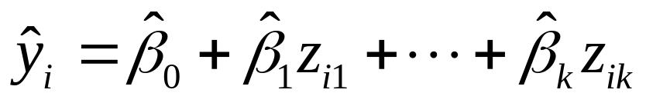
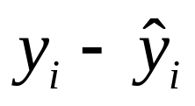
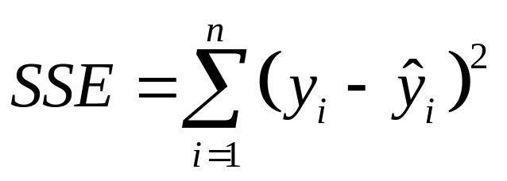
Sum of Squares Due to Error
Let denote the estimated value of the dependent variable using the linear regression model. is called the i th residual (残差).
Sum of squares due to error:

Slide 23


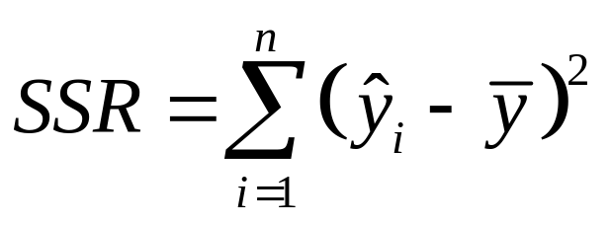
Sum of Squares Due to Regression
Measures how much the values on the estimated regression line deviate from .
Note that the mean of is also .
Sum of squares due to regression:

Slide 24





Y
X

Slide 25
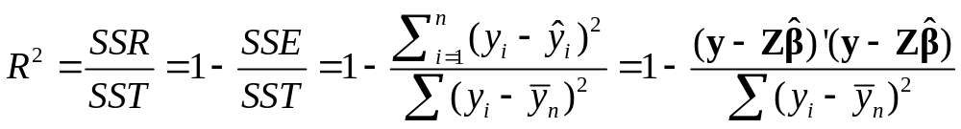
R Square
Define coefficient of determination (R Square)
It is the proportion of variation in Y explained by the regression.

Slide 26
F Test
F test can be used to test for an overall significant relationship between the response variable and all of the explanatory variables.
H₀: β₁ = … = β_{k} = 0
H₁: At least one β_{j} (j=1,…,k) is not equal to zero.
at least one of the independent
variables z1,…,zk is linearly related to Y

Slide 27
Excel output
52.51% of the variation in the
measure of profitability is explained
by the linear regression model.

Slide 28
Excel output
p value for F test. Thus, at least
one independent variable is
linearly related to y.

